Slide 1
Directions
Get the 5 sheets of paper off of the computer cart
Turn in your Document Analysis Sheet and Document Analysis Questions
Grab a Chromebook
Turn in Play posit – Immigration
There should be THREE stacks on the bookshelf.

Slide 2
Chapter 18 – The Growth of Cities and American Culture
1865-1900

Slide 3
Boss tweed
As you watch the following video, you must notate 5 facts from the video on a separate sheet of paper.
They must include reference to the following
Boss Tweed
Political machines
Tammany Hall
Immigration
Political corruption
Notes:
The video is 9 minutes long, you will need to make sure you space yourself with the facts. Get the headphones from Mrs. Zuniga, they are in the back cabinet in a red bag.

Slide 4
Video analysis
https://www.youtube.com/watch?v=YildL_ilQFY&t=328s
Notes:
This video is directly linked on the website.

Slide 5
Document analysis prompt
Evaluate the extent to which the social and economic issues face by immigrants were the cause of the growth of political machines.
Notes:
When working through the document in the power point, you will want to reference this prompt in the section “how does this document answer the prompt”. I would suggest that you write it down on a separate sheet of paper.

Slide 6
BIG BUSINESS ≠ POLITICAL MACHINES
Political machines appealed to the immigrants of the Democratic Party.
They gained their power from the immigrant population
Notes:
It is important to note that Big Business and political machines ARE NOT the same thing. Political machines have political implications, while big business in more economic. Big Business does corrupt government officials. However, Political machines, are the corrupted government officials. They can their power directly from the less fortunate. Specifically, the immigrant populations.

Slide 7
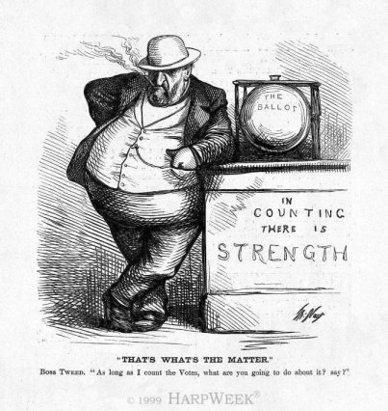

Slide 8
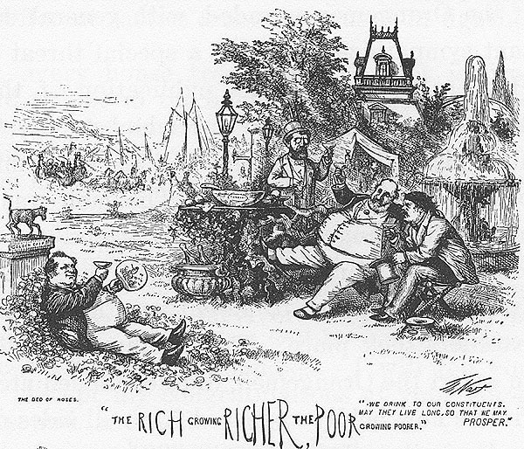

Slide 9
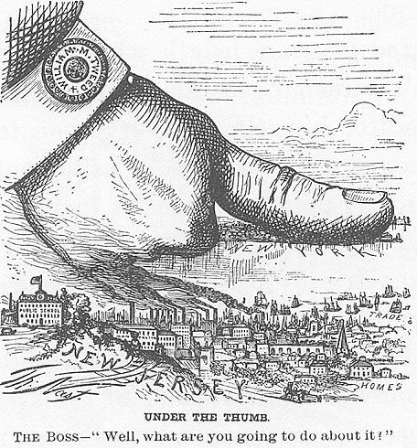

Slide 10
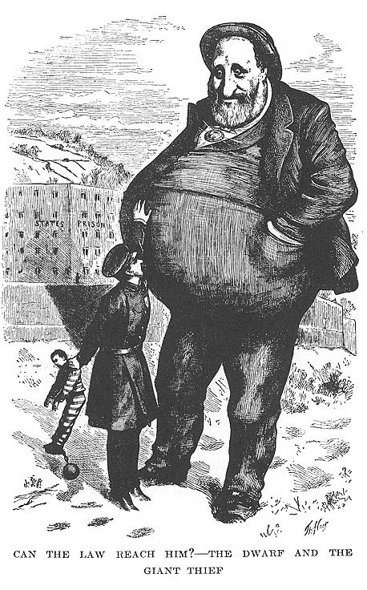

Slide 11
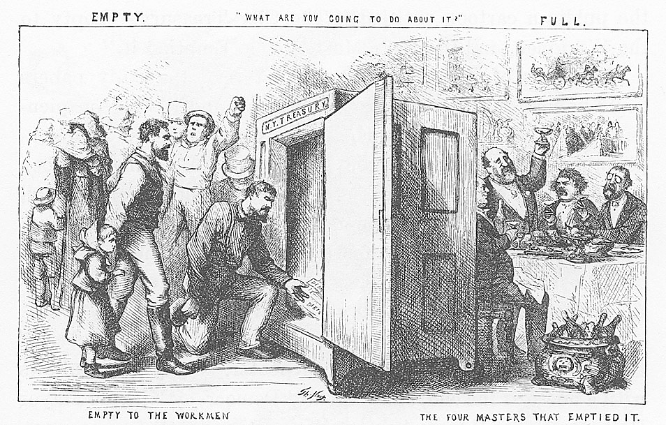

Slide 12
Reform
What did the Gilded Age reformers have in common with Antebellum reformers?
Awakening of Reform
Books of Social Criticism
Inequalities of Wealth
Settlement House
Social Gospel
Religion and Society
Explain how and to what extent industrialization created the problems facing cities during the Gilded Age.
Notes:
The purpose of settlement house was to provide immigrants with a place to “settle”. It was like a transitioning house or what we would call a half way house today. In these houses, immigrants were provided with food, clothing, a place to sleep. They were given medical care. Additionally they were provided with minimal educational skills so that they could find jobs.
We have talked about the impact of industrialization before. In our thesis prep last class. Take a moment to think about in what ways industrialization create problems. You need to provide at least 3 examples, and explain, on your response form.

Slide 13
Women and Families
How and why did women assume a larger place in American society at this time? (pre–Civil War) How were changes in their condition related to changes in both the family and the larger social order?
Families in Urban Society
Divorce rates go up, birth rates go down
Temperance
18th amendment – prohibited the sale and consumption of alcohol
21st amendment – brought it back
Urban Reforms
Notes:
It is important to note that women are beginning to move away from the mentality that there sole purpose is to have children and be a wife. The 19th amendment is just a hop skip and a jump away.

Slide 14
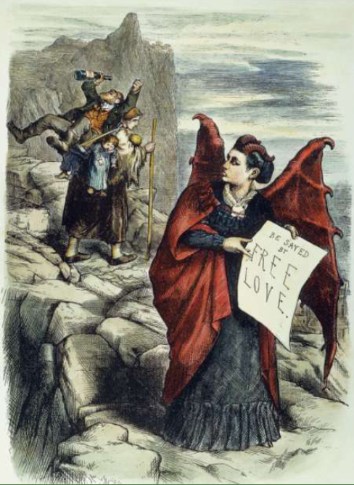
“Get Thee Behind Me, (Mrs) Satan!”
A colorful and charismatic figure, Victoria Claflin Woodhull was the first woman to run for the presidency, in 1872. That same year, noted cartoonist Thomas Nast viciously attacked her for advocating free love.
Notes:
What does this image say about the growing beliefs of women during this time?

Slide 15
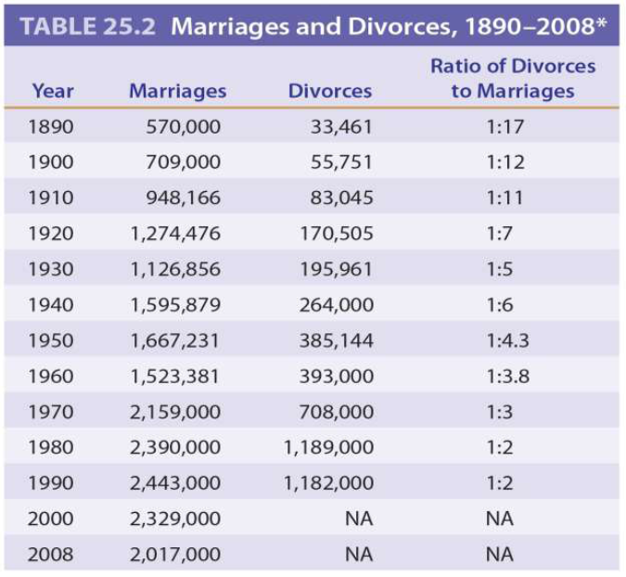
Notes:
Look for trends in the graph. What d you see happening over time? In more modern times?

Slide 16
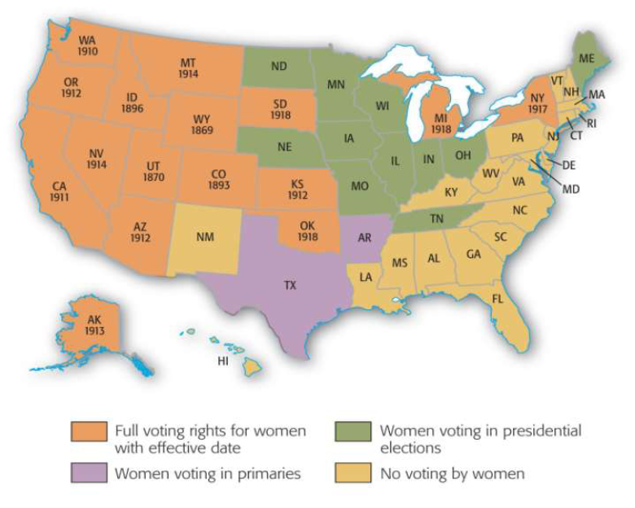
Notes:
What does this map tell us about the women’s rights?

Slide 17
Intellectual Movements
Explain how the scientific method impacted American culture during the Gilded Age.
Changes in Education
Public Schools
Higher Education
Social Sciences
The Professions
Notes:
Horace Mann will push forward the thought that children should be in school. During the progressive era, this is idea is further solidified with the passage of the Child Labor Laws, which restrict the age, hours, and times that minors can work.
Higher education was still reserved primarily for white males. When women did go to college, which was more common now, it was to primarily locate themselves a husband. Once they were married, it was expected that they would then quit going to school. This mentality will really not change until the late 1960’s.

Slide 18
Cultural Movements
How did cultural change create social conflict?
How did cultural change illustrate class and gender structure?
Literature and Arts
Realism and Naturalism
Painting
Architecture
Music
Popular Culture
Popular Press
Amusement
Theatres, Barnum and Bailey (circus)
Spectator Sports
Amateur Sports

Slide 19
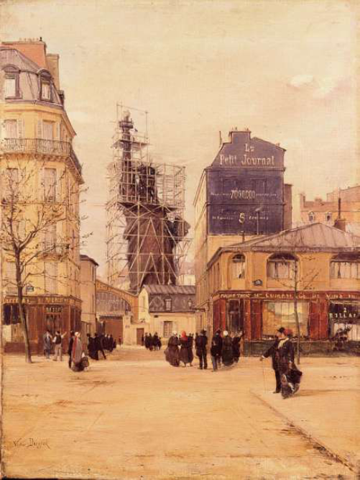

Slide 20
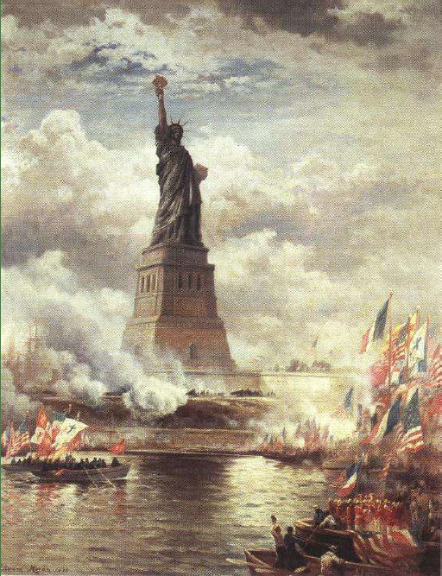
Notes:
1886 – The Statue Liberty was placed in New York City, it was a gift from the French
It was in eyes view of what would later be Ellis Island

Slide 21
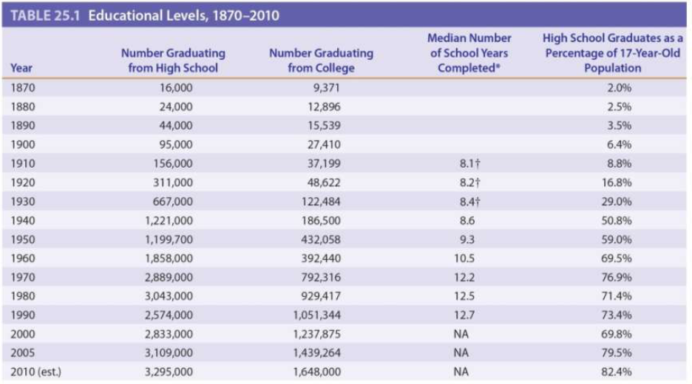

Slide 22
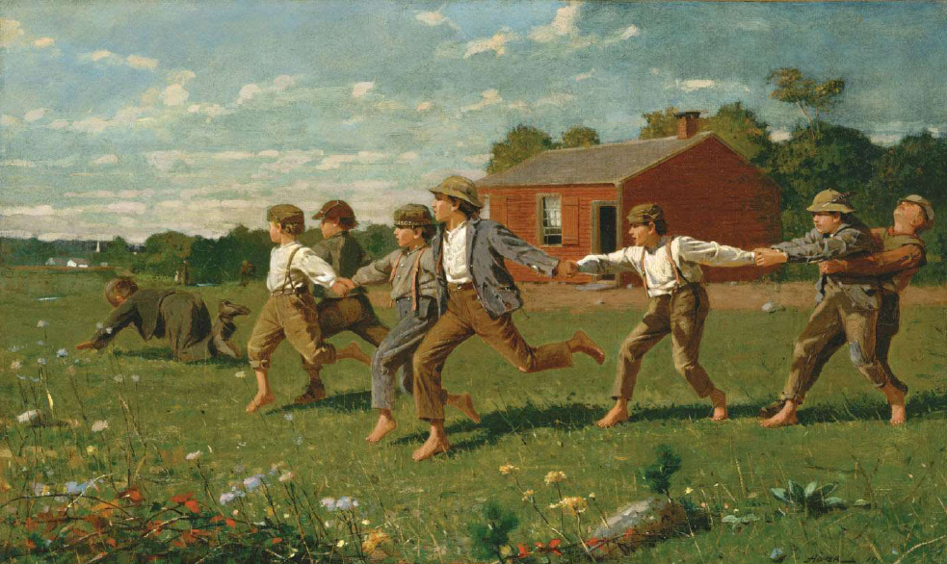

Slide 23
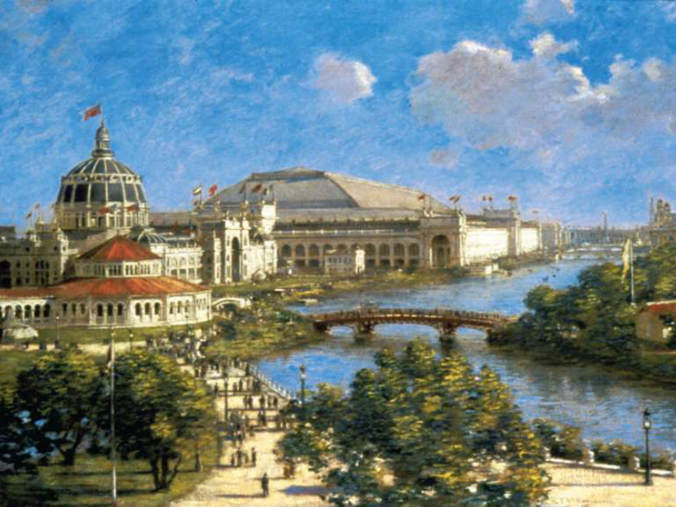

Slide 24
Melting Pot vs Salad Bowl
To what extent did immigrants give up their heritage to become Americanized, or fully assimilated into the existing culture?
To what extent did immigrants retain their heritage to become unique, new thread in the American fabric?
Notes:
“Melting Pot” – you all ‘melt’ together to become one (Americanization)
“Salad Bowl” – a bunch of things come together to create something really good

Slide 25
Extra Credit – Launch Lesson
On a sheet of paper title it Launch Lesson
Each day in class, at the end of class you will be given a launch.
Write down the date of the launch, and the launch information that was provided.
You will be able to use this sheet as extra credit on your tests!!!

Slide 26
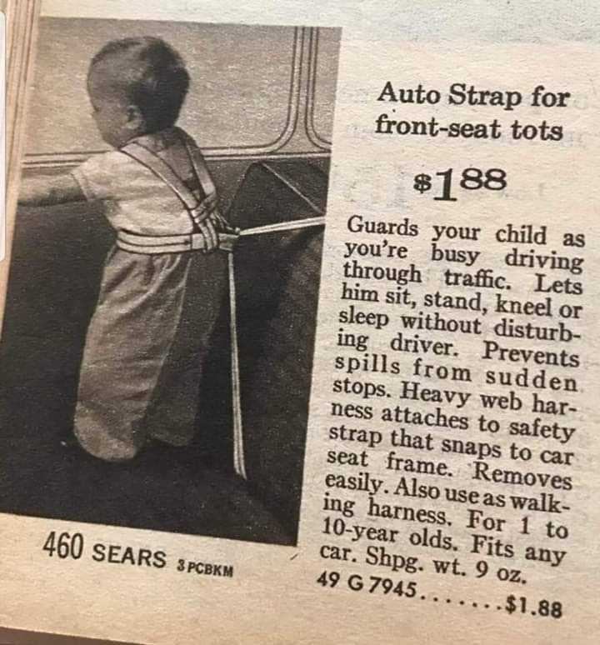
Launches
https://www.youtube.com/watch?v=yibNEcn-4yQ
Janunary 28, 1986

